Slide 1


Welcome to the experiment!
Before we start, we will ask you to rate some paintings according to how much you like them.
Please use the mouse to indicate your rating, as shown below.
Not at all
Very much
How much do you like this painting?
Continue

Slide 2
Now we will start the experiment.
Your job in this experiment is to be an art dealer. First, you will choose paintings for an upcoming auction. Then the paintings will go on auction and you will find out whether you profited from each painting or not. Your goal should be to choose paintings that will maximize your profits.
One of your decisions will be played out for real, and you will receive 1% of the auction earnings for your chosen painting (for example, if the painting earned $157, you will receive $1.57, if it resulted in no earnings, you will not receive a bonus for this phase of the experiment).
So, get ready to make some choices.
Please take your time and consider each choice carefully. Because these choices are important, we will give you a chance to practice making each choice a couple of times before you commit to your final decision.
We are interested in your deliberation process, so we may occasionally ask you to share with us the reasons for choosing one specific painting over the other painting. In these explanations, you may refer to any internal thoughts or external features that led to your decision.

Slide 3
Now we will start the experiment.
Your job in this experiment is to be an art dealer. First, you will choose paintings for an upcoming auction. Then the paintings will go on auction and you will find out whether you profited from each painting or not. Your goal should be to choose paintings that will maximize your profits.
One of your decisions will be played out for real, and you will receive 1% of the auction earnings for your chosen painting (for example, if the painting earned $157, you will receive $1.57, if it resulted in no earnings, you will not receive a bonus for this phase of the experiment).
So, get ready to make some choices.
Please take your time and consider each choice carefully. Because these choices are important, we will give you a chance to practice making each choice a couple of times before you commit to your final decision.
We are interested in your deliberation process, so we will occasionally ask you to share with us the reasons for choosing one specific painting over the other painting. In these explanations, you may refer to any internal thoughts or external features that led to your decision.

Slide 4
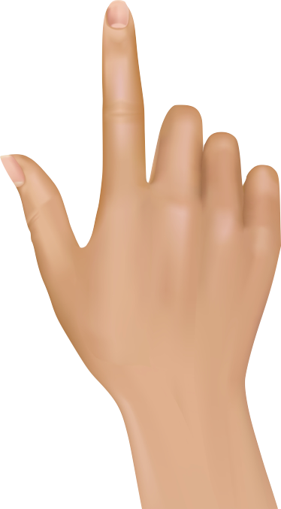
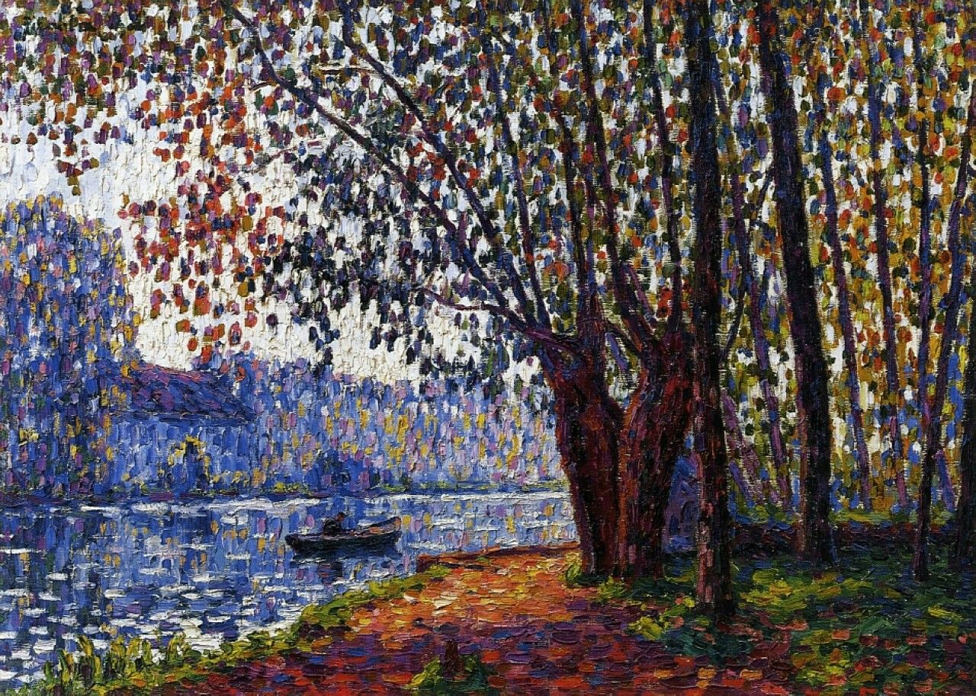

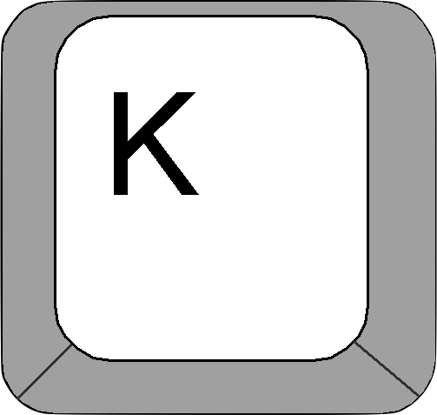
Please place your right index finger on the “K” key, and your left index finger on the “D” key (as presented below).
Press “K” to choose the right painting, and “D” to choose the left painting.
You will have up to 10 seconds to make your choice, giving you plenty of time to consider it carefully.
Which painting do you choose?
Which painting do you choose?

Slide 5
Are you ready to find out how well your selected paintings did at the auction?
We will show you whether each painting you chose was sold with a gain (sold higher than the price you paid for it), or with no gain ($0 earnings). Two examples are shown below.
We will also tell you at the end of this phase whether and how much extra bonus money you earned from your decisions (remember, one of those will be played out for real earning).
Later in the experiment, this information will help you earn more bonus money.
$0 Earnings
Gain of $157

Slide 6
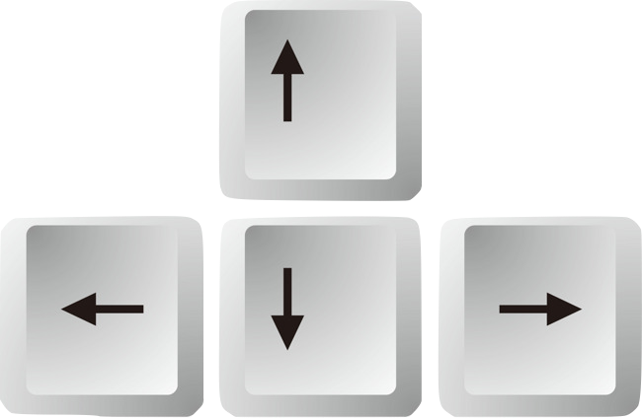
To help you learn better, we will present the outcomes for your selected paintings several times.
To observe the outcomes, you will need to respond, as follows:
When the painting appears, press the SPACE bar.
When the outcome appears, press “down arrow” for No gain, and press “up arrow” for Gain.
Use your left hand to press the SPACE bar and your right hand to press the up or down arrows.
$0 Earnings
Gain of $157

Slide 7
Now that you are an expert art dealer, you are asked to prepare a portfolio of high-value paintings.
You will make a series of new choices among paintings.
We will pay you additional bonus money based on your choices in this phase of the experiment.
Please place your right index finger on the ”K” key, and the left index finger on the “D” key.
To choose the left painting press “D”, and to choose the right painting press “K”
You will have up to 2.5 seconds to make each decision.
Which painting do you choose?
Which painting do you choose?

Slide 8
Let’s check what you remember from the beginning of the experiment where you had to decide which painting should go on auction (up to 10 seconds).
You will see pairs of paintings. Please tell us whether you already saw this exact pair in the beginning of the experiment (”Intact”/up arrow) or whether this is a recombined pair you have not seen before (“Recombined”/down arrow). Recombined pairs include paintings you have seen before, yet not in this unique pairing.
We will also ask you what you remember about the choices you made in the beginning of the experiment (using “D” and “K” keys).
Is this pair
Intact (up) or Recombined (down)?
Which painting did you choose?
Which painting did you choose?
INTACT

Slide 9
In this next phase, you are asked to rate how much you like the paintings you’ve seen
throughout the experiment.
Please use the mouse to indicate your rating, as shown below.
Not at all
Very much
How much do you like this painting?
Continue

Slide 10

Before the experiment ends, we will ask you to tell us what the outcomes of the auction were.
In the beginning of the experiment, you chose paintings to go for auction and learned how much they profited. Later on, the remaining paintings (those you didn’t choose) also went on auction.
In this phase of the experiment, we will show you all the paintings you deliberated about (both those you chose and those you didn’t choose).
For each painting, please estimate whether it resulted in a GAIN (up arrow) or NO GAIN (down arrow) from the auction. Then, please rate how confident you are in your response.
What was the auction profit of this painting?
Gain (up) / No gain (down)
GAIN
1
Completely
unsure
6
Completely
sure
2
3
4
5
How confident you are in your response?
Continue

Slide 11
You will now take a short quiz to make sure you understood the instructions.

